Slide 1
Quality Circle Forum of India
presents
Problem Solving Techniques
- a simplified revised practical guide

Slide 2


Slide 3
What is Sratification?
Stratification is the process of separation of data into categories.
It is normally done for identifying the categories contributing to the problem tackled.

Slide 4

Mumbai, we have a problem !!
It is too complicated !!
Then Stratify it!!
What is it ?
Stratification is the process to classify large amount of data to find out whether we can get indication of problem point.

Slide 5
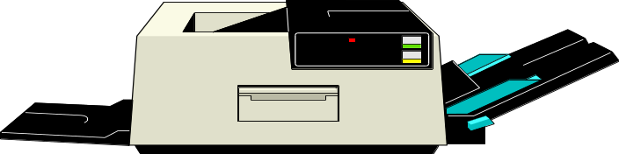
Reasons for Bad Quality of a print from an inkjet printer could be
1) Colour in the Cartidge is over.
2) Colour Cartidge inserted at the wrong slots.
3) Printer Head requires cleaning.
4) Improper matching of the colour monitor with the printer.
5) Incorrect parameters chosen for printing.
6) Adobe Type Manager version not compatible with the Operating System.
7) Paper used for printing too glossy.
Quality is influenced by multiple causes or elements.

Slide 6

We are studying the symptoms. It is very difficult to determine the cause of the fever at this stage.
Compounding of effect of these causes make it difficult to find a clear relationship between element and quality i.e. between causes and result.

Slide 7
For this purpose we categorise or group data in a particular way, whereby the group has an identity of its own.

Slide 8
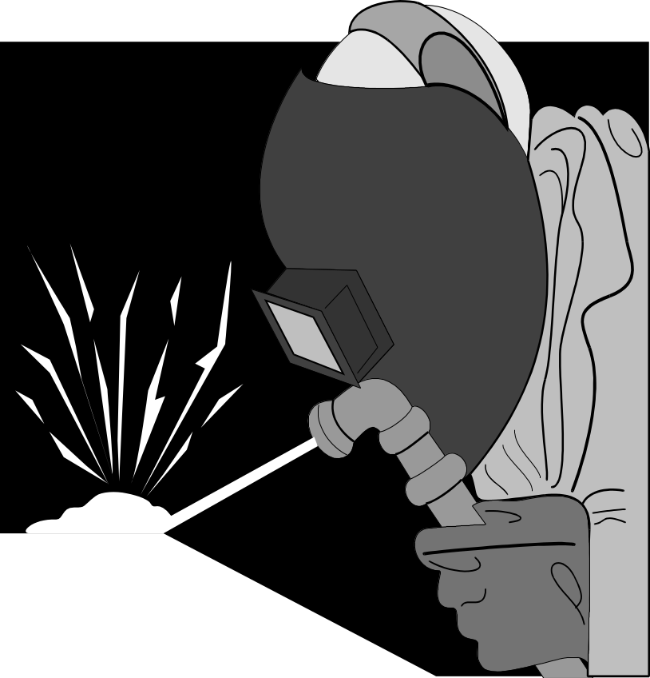
For example, in a company the final finished product’s defect level was above I0%, which was not desirable.

Slide 9

Four weeks of training has produced nothing. No improvement at all !!
Further training and awareness programme of operators were not helping the situation.

Slide 10

Hey, why not segregate the production operator wise. Maybe that could give a clearer picture !!!
Then they came out with the idea of segregating the production operator wise.

Slide 11
40
Worker A
35
Worker B
30
Worker C
No. of defective parts
Worker D
25
Worker E
20
Worker F
15
Worker G
10
Worker H
5
Worker I
0
Worker J
It was found out 5% of the operators were responsible for more than 40% of the defect. This was because they lacked the skill of performing the job.

Slide 12

SEPTA INDUSTRIES LTD.
In a manufacturing organisation absenteeism was very high.

Slide 13
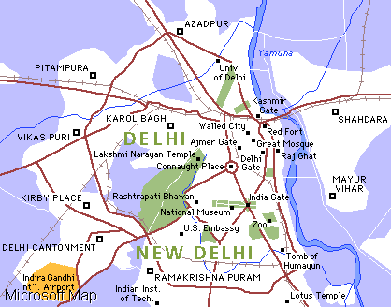
Staff
Quaters
Septa Inds. Ltd.
They had 60% of the employees staying in the colony and balance in the city which was 20 Kilometres away.

Slide 14
Absenteeism
was first
segregated
month wise.

Slide 15
60
Jan
Feb
50
Mar
Apr
40
May
Number of Absentees
Jun
30
Jul
Aug
20
Sep
Oct
10
Nov
Dec
0
It revealed that it was more in January, May, June and December.

Slide 16
It was further stratified shift wise.

Slide 17
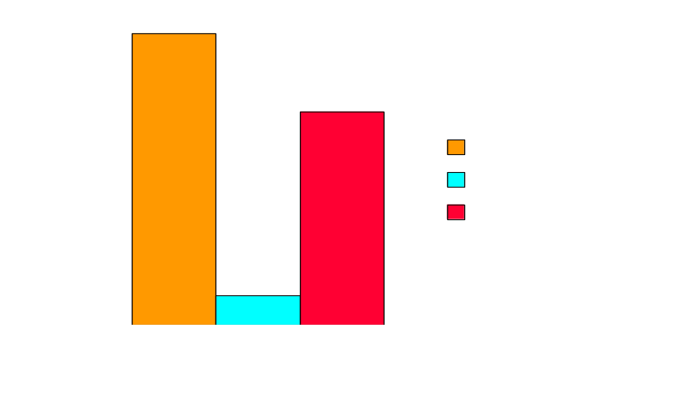
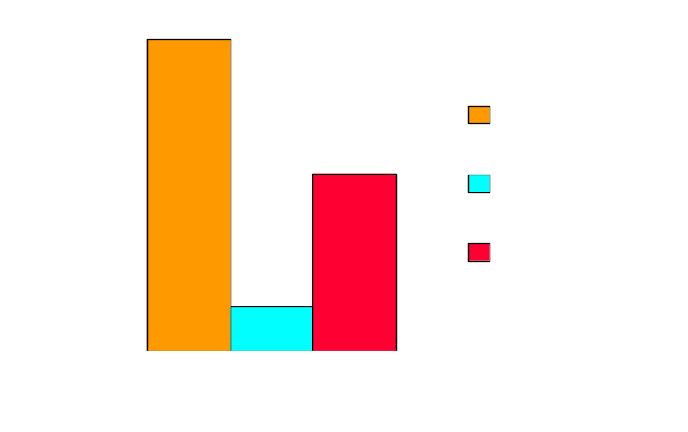
JANUARY
Number of Absentees
DECEMBER
Number of Absentees
It was found that in December and January it was more in early morning shift starting at 6 AM and in night shift starting at 10 PM

Slide 18
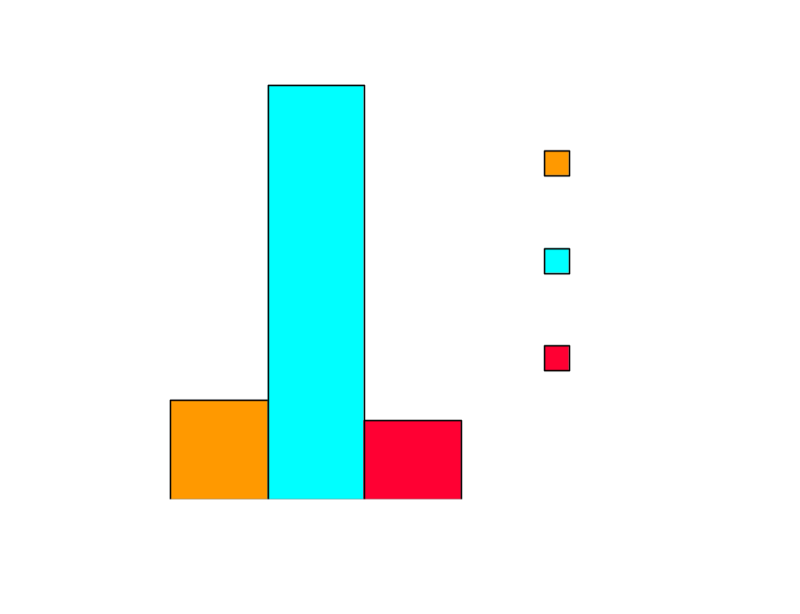
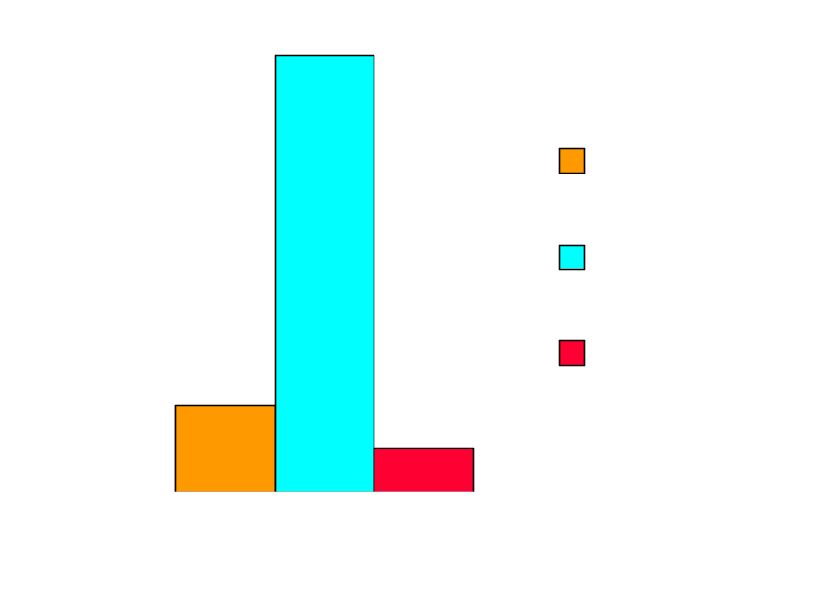
MAY
JUNE
Number of Absentees
Number of Absentees
In May and June it was during shift starting at 2 PM.

Slide 19
Then it was checked as to
how many of the colony people were
absent and how many from the city.

Slide 20
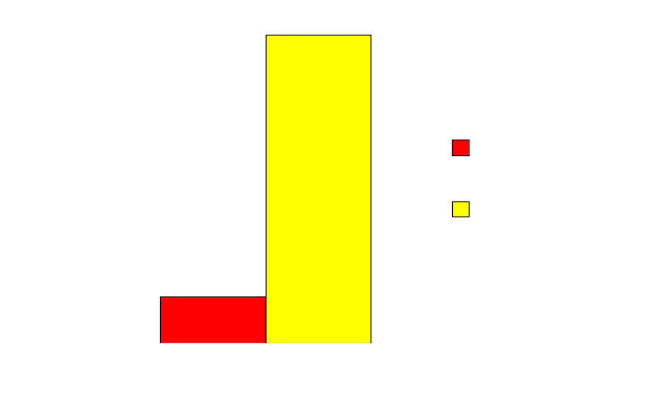
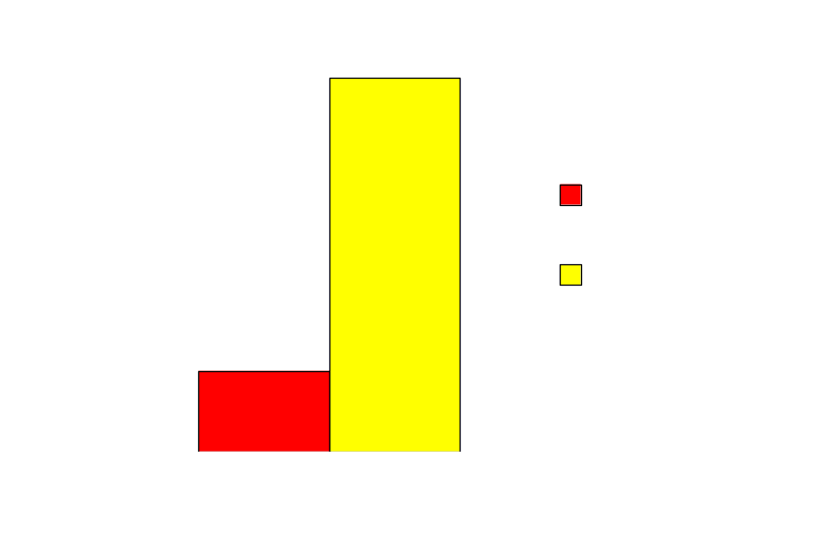
In the months of December & January
Number of Absentees
In the months of May & June
Number of Absentees
Further Stratification revealed that people residing in the city were absent in most of the cases.

Slide 21

I think we should put more of colony people in the problem shifts.
This helped to workout an action plan.

Slide 22
Keeping this point in mind data are normally collected so that it is self revealing and serves the purpose of getting right answers.

Slide 23
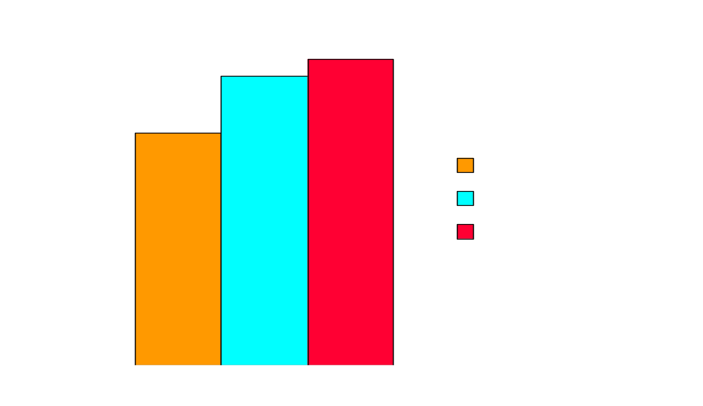
% Defects
Again, for example, to find the sources and causes of defects in finished compressors, data are collected separately according to shift,

Slide 24
Assembly Line
40
A
35
B
30
C
D
25
% Defects
E
20
F
15
G
10
H
5
I
0
J
according to assembly line,

Slide 25
40
35
Worker A
Worker B
30
Worker C
25
Worker D
% Defects
Worker E
20
Worker F
15
Worker G
Worker H
10
Worker I
5
Worker J
0
according to workers etc....

Slide 26
As another example consider customer complaints.
These could be segregated by what the complaints are about viz...
a) Defective product
b) Insufficient Quantity
c) Incorrect shipment
d) Damaged product
e) Delayed delivery

Slide 27
COMPLAINTS RECEIVED BY TELE SHOPPING NETWORK IN THE MONTH OF FEBRUARY 1996 ( NO OF COMP.= 423)
140
120
Defective product
100
Insufficient
Quantity
80
Damaged Product
60
Incorrect
40
Shipment
Delayed Delivery
20
0
STRATIFIED ACCORDING TO NATURE OF COMPLAINTS

Slide 28
Segregation can also be by source of trouble such as
a) Factory
b) Warehouse
c) Sales Outlet

Slide 29
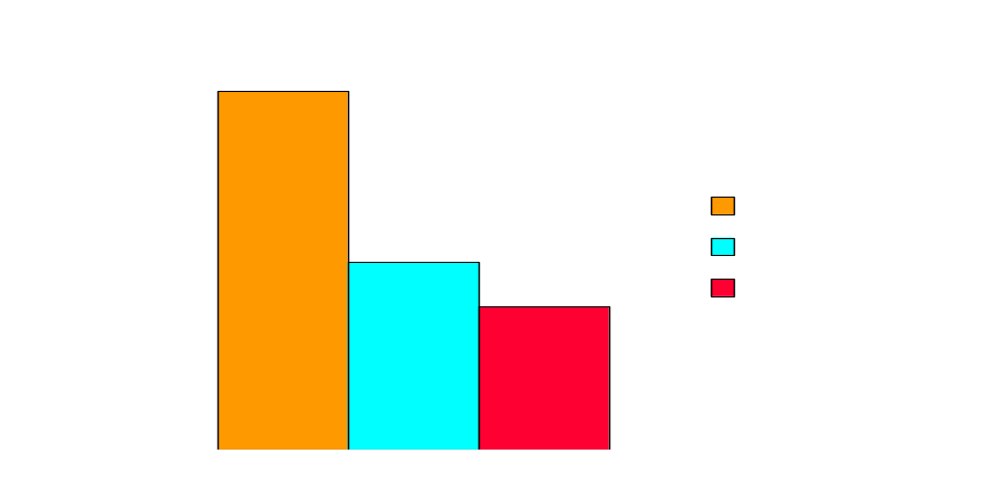
COMPLAINTS RECEIVED BY TELE SHOPPING NETWORK IN THE MONTH OF FEBRUARY 1996 ( NO OF COMP.= 423)
STRATIFIED ACCORDING TO SOURCE OF TROUBLE

Slide 30
Or they could be segregated by the department responsible such as
a) Design
b) Manufacturing
c) Inspection
d) Distribution
e) Sales & Service

Slide 31
COMPLAINTS RECEIVED BY TELE SHOPPING NETWORK IN THE MONTH OF FEBRUARY 1996 ( NO OF COMP.= 423)
200
180
160
140
Design
120
Manufacturing
100
Inspection
80
Distribution
60
Sales & service
40
20
0
STRATIFIED ACCORDING TO DEPARTMENT RESPONSIBLE

Slide 32

Well, that was easy !!!
Such categorisation helps to classify the problem and makes it easier to solve.

Slide 33
This method of collecting data
classified into sources or
segregating the data
into sources
is called
stratification.

Slide 34
STEPS
FOR
STRATIFICATION

Slide 35
With our experience of working in an area, we normally know depending upon the problem what Stratification variables have to be selected.
Even then what is given below should serve as a guidance in case we are probing into an unknown area.

Slide 36
STEP 1
Let us understand the problem thoroughly.
Try to have the clarity of the problem. This will normally help to identify the Stratification variables to be selected.

Slide 37
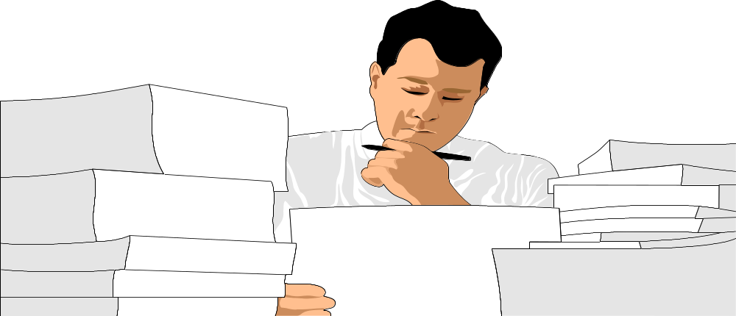
STEP 1
If we have ready information and if they are reliable they can be straight away used, otherwise, start collecting data needed.

Slide 38

STEP 1
Make sure all Stratification variables are identified for data collection.

Slide 39

STEP 2
Data collected may be enormous

Slide 40

STEP 2
Which will call for establishing categories for each Stratification variable

Slide 41
STEP 2
The categories may be discrete values or range of values.
For example, size of categories in sales analysis may be-
Less than 10, 10 to 20, 20 to 30 etc....
In the case of time in a day, it may be
6 - 8 AM, 8 - 10 AM, 10 - 12 noon etc....
the intervals being equal

Slide 42
STEP 3
Let us sort out the data into the categories of Stratification Variables

Slide 43
STEP 4
Now summarise the interpretation in each category.

Slide 44

STEP 4
They are simple numbers. We should total them

Slide 45

STEP 4
It is a range of values and I think it needs to be further classified.

Slide 46
STEP 4
For example: During a riot period a company which was affected by absenteeism was interested in knowing where the employees were staying.

Slide 47
STEP 4
They were categorised accordingly viz... persons staying in different localities which further called for classification as the trouble areas.

Slide 48
STEP 4
Number of employees staying in different parts of the city.
100
Shastri Nagar
90
Lal kurti
80
Lisadi Gate
70
Delhi Gate
No of employees
Baccha Park
60
Abu lane
50
Saket
40
Jali kothi
30
Nehru nagar
20
Gandhi Bag
10
Moti Chowk
0
Kali basti

Slide 49
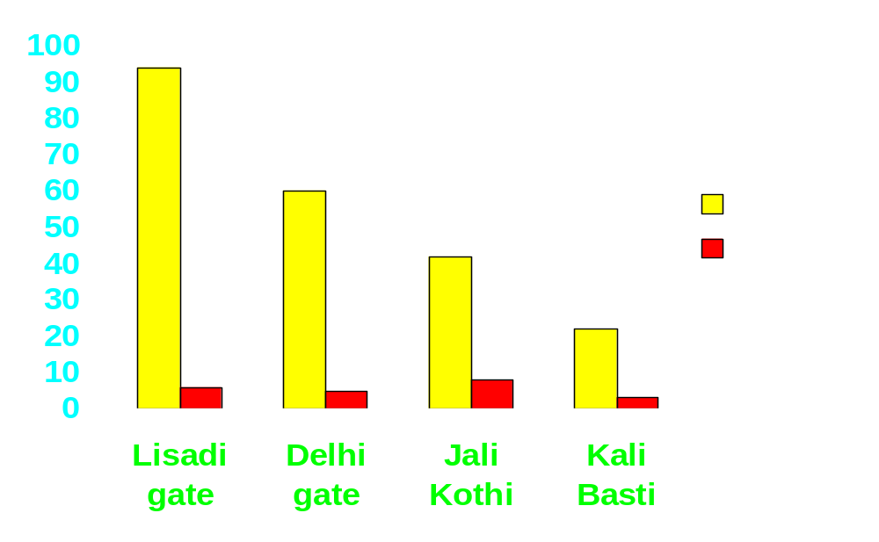
STEP 4
Persons at the centre of it,

Slide 50
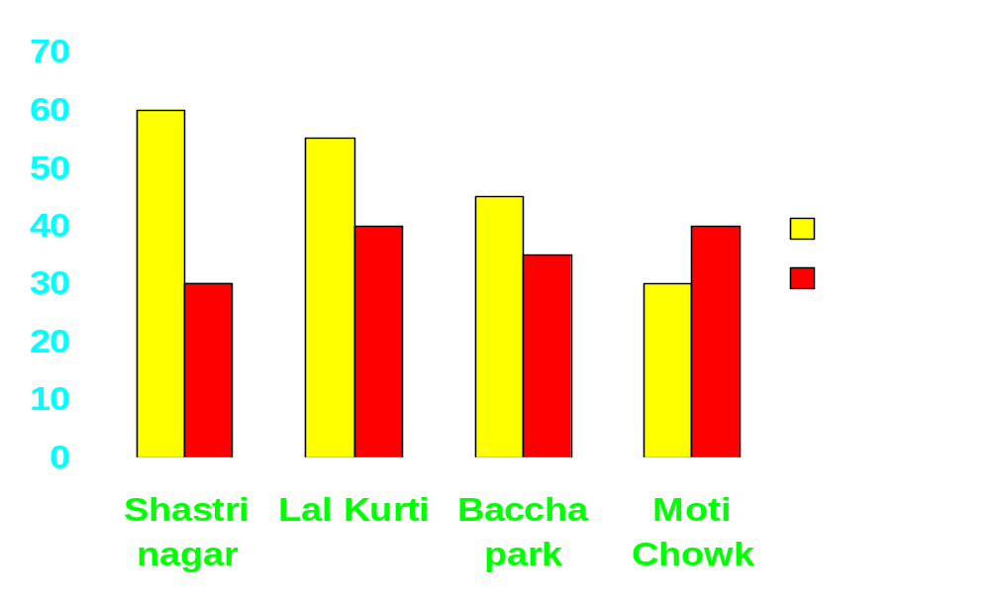
STEP 4
At the vicinity and

Slide 51
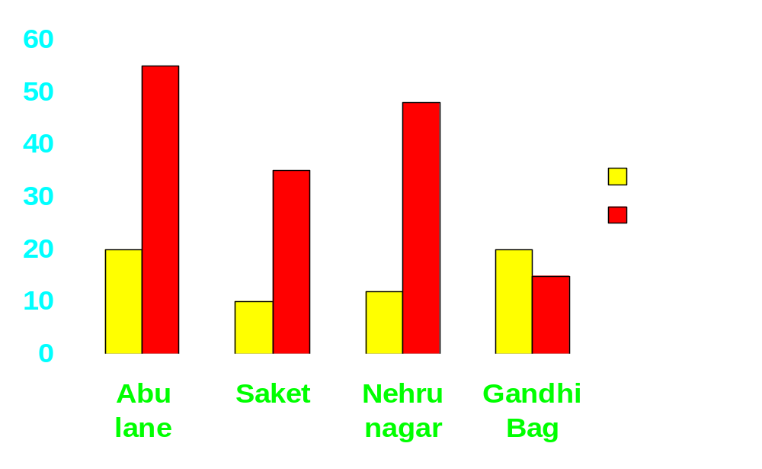
STEP 4
Safely far away from it etc.

Slide 52
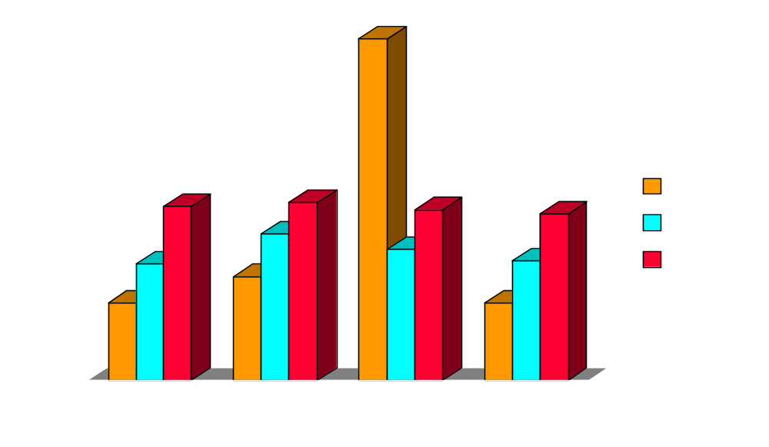
STEP 5
Present the result in graphic form to enable effective communication.

Slide 53

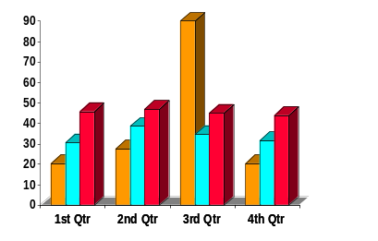
STEP 6
Study the display.

Slide 54

STEP 6
If you feel that Stratification has to be done in a different way go ahead and do it on the same lines as stated.

Slide 55
STEP 6
MACHINE BREAKDOWN IN THE VARIOUS UNITS OF BHEL
DURING 1995
40
36
32
28
UNIT 6
24
UNIT 2
%
UNIT 3
20
UNIT 1
16
UNIT 4
12
UNIT 5
8
4
0
Sometimes stratified information need to be further stratified.

Slide 56
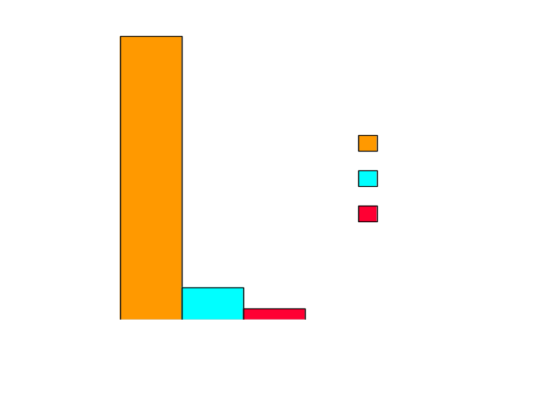
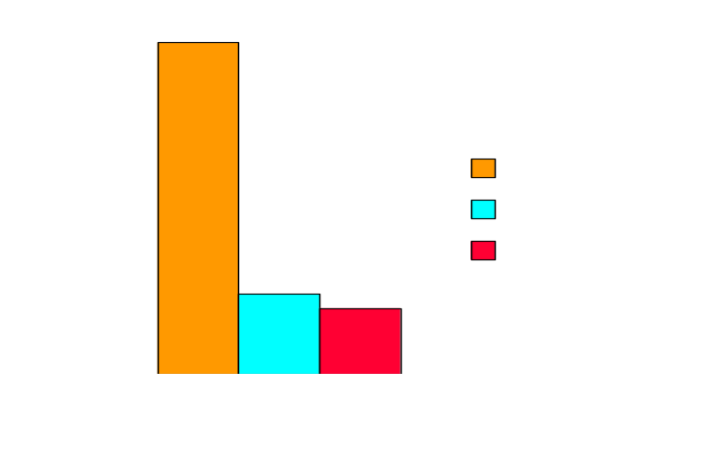
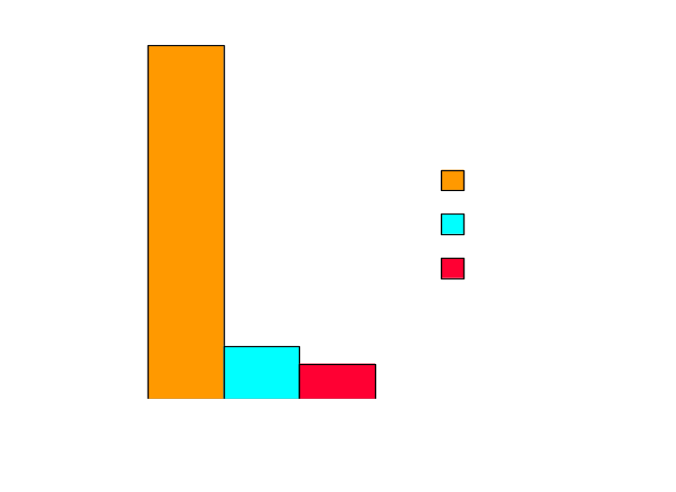
STEP 6
UNIT 2
UNIT 1
UNIT 3
let us stratify the machines in the first three units of the previous problem supplier wise
Do it if necessary

Slide 57

STEP 7
Once you are satisfied with the Stratification, collect additional information if necessary to ensure that the interpretation is right.

Slide 58
STEP 8
Always present the total information of the work done in an orderly manner to satisfy the concerned that all aspects connected to the problem are covered

Slide 59
STRATIFICATION
SOURCES
OR
BASES

Slide 60
There are many - Based on material, machine, operator, time/season, supplier, customer and department; Again department wise, design, manufacturing, material handling, quality control etc.

Slide 61


The engineer and the supervisor must be creative enough to find and choose the best specification base for the problem on hand. Stratification is carried out as under

Slide 62
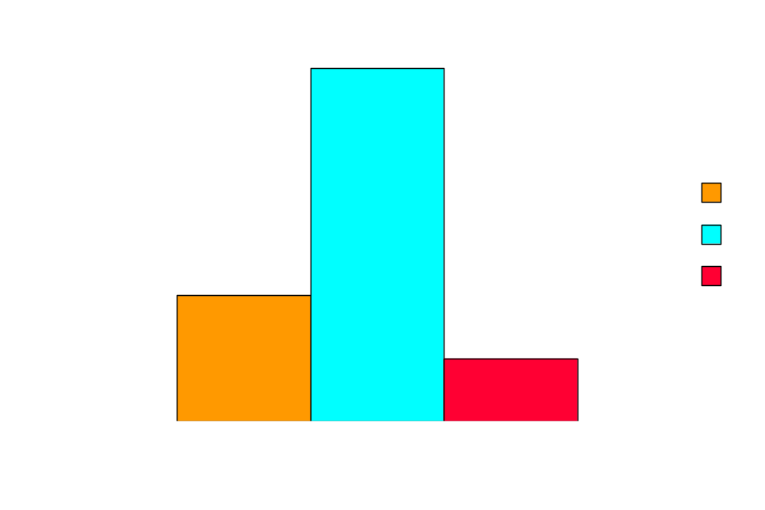
Material based
DEFECTIVE QUALITY - SUPPLIER WISE
Defective %

Slide 63
Quality based
DEFECTIVE DATA IN A SHIFT
50
45
40
35
Nar Bead
30
Kinked Bead
Defective %
Pulled Bead
25
20
Pinched Bead
15
Other
10
5
0
Type of defect

Slide 64
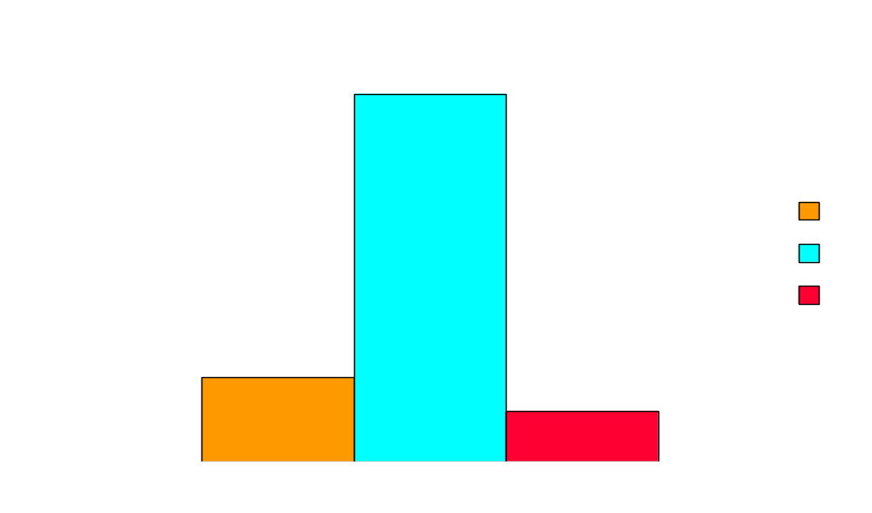
Worker Based
DEFECTIVE ASSEMBLIES
DEFECTIVE %
WORKER

Slide 65
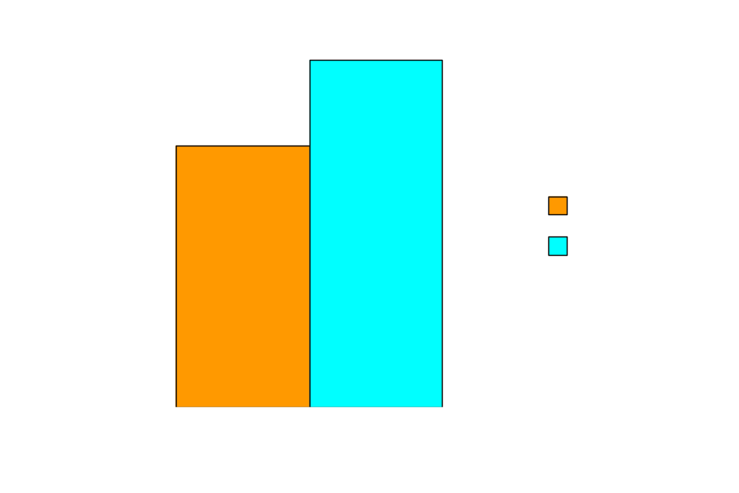
Machine Based
Production machine wise
Production %

Slide 66
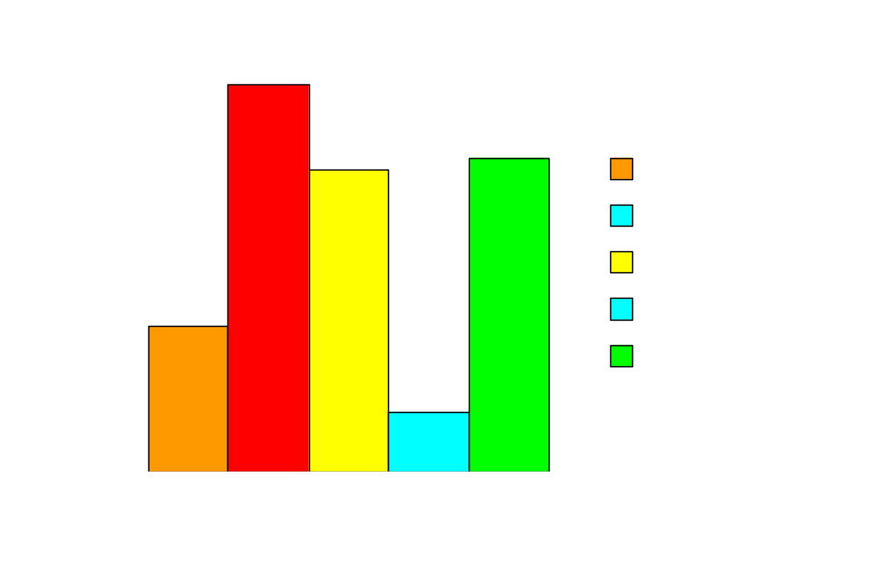
Processing Based
Power consumption process area wise
Power consumption %
Process area

Slide 67
INTERPRETATION
OF
STRATIFIED
ANALYSIS

Slide 68
140
120
Defective product
100
Insufficient
Quantity
80
Damaged Product
60
Incorrect
40
Shipment
Delayed Delivery
20
0
Present first the stratification in the form of a graph - usually a bar graph to reveal relative comparison of magnitude of effect of each categorised elements

Slide 69
60
Jan
Feb
50
Mar
Apr
40
May
Number of Absentees
Jun
30
Jul
Aug
20
Sep
Oct
10
Nov
Dec
0
Usually time will reveal one or more elements/variables explaining a larger portion of the problems.

Slide 70
If no category stands out, then it will be necessary to look for other characteristics

Slide 71
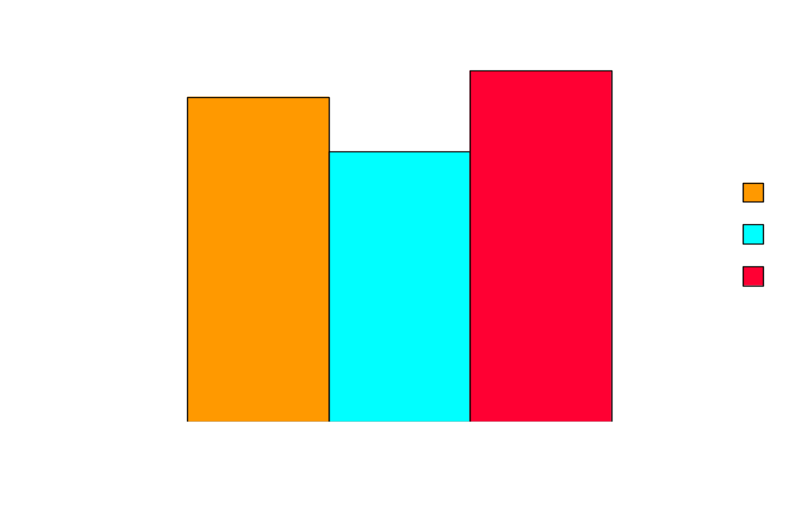
Defective %
For example if defect rates do not stand out for any particular supplier

Slide 72
Defect rate % in different production Llne
10
9
Line 1
8
Line 2
7
Line 3
%
6
Line 4
5
Line 5
4
3
Line 6
2
Line 7
1
Line 8
0
then stratify defect rates in different production lines

Slide 73
SUMMARY
Stratification is separation of data into groups.
Helps in testing theories - some are proved, other are disproved.
Usually requires several different classifications, two stage stratification is common.
Best interpreted in graphic form.

Slide 74

Prepared by
G. Vijaykumar

Slide 75


